Slide 1
UVR
Dr. Gaurav C. Mhaske
Dept. Of Neurophysiotherapy
MGM Institute Of Physiotherapy
Chh. Sambhajinagar

Slide 2
Content
Introduction​
Production
Physical Principle
Panel Diagram
Testing of Apparatus
​Summary​

Slide 3
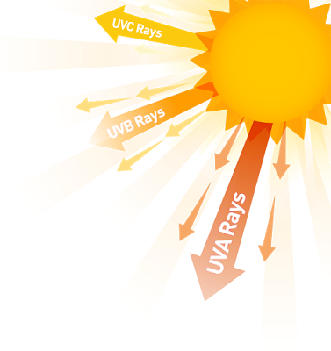
Introduction
Radiations between visible and x-ray sections of the electro-magnetic spectrum (390 - 400 nm visible end to soft x-ray region) are called as the Ultraviolet Radiations.
They were termed as UVR (Ultra Violet Radiations) by John Ritter in 1801 (invisible radiations beyond the violet end of the spectrum.
Radiation is used to refer to any electromagnetic waves. It arises from the Egyptian word for the Sun God, Aton Ra.
Heliotherapy, is derived from a Greek word (Helios – Greek God of Sun), and is used for treatment by the sun’s radiations.
Another Greek word Actis, a ray, is used in combination with Actinotherapy which implies treatment by any rays but is usually used to indicate radiations with wavelengths near to the visible.
Phototherapy implies treatment by radiations in the ultraviolet and visible regions.

Slide 4
Nature of UVR
UVR are recognized as the wavelengths that cause sunburn and tanning on exposure to the sun (some of them produce these effects).
UVR behaves like visible radiations, except they are more strongly absorbed in the air, in particular the wavelength UVR.
UVR transmits much more energy than visible radiations, so it is able to provoke chemical changes and not simply heat at the sites where they are absorbed.
Oxygen and Ozone in the stratosphere screen out UVC and much UVB from the sun’s radiations.
Wavelengths between 200 – 100 nm and below it are often called Vacuum UV , as they are rapidly absorbed in air, and can only effectively passed in vacuum.
Lower limit for therapeutic UVR is 180 nm because shorter wavelengths are not transmitted through the quartz envelopes of the therapeutic sources used.

Slide 5
UVR spectrum
Region | Wavelength | Other Names
 |  | Biotic
UVA | 400 - 315 nm | Long UV, Blacklight
UVB | 315 – 280 nm | Medium UV, Erythmal UV
 |  | Abiotic
UVC | 280 – 100 nm | Short UV, Germicidal UV

Slide 6
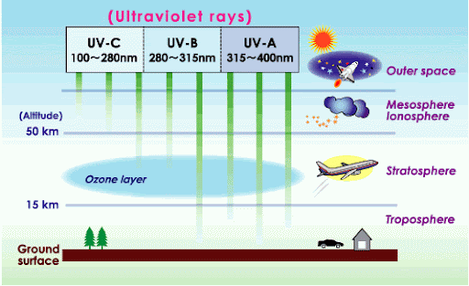
UVR spectrum

Slide 7
Production of Ultraviolet Radiations
Ultraviolet rays are emitted by the sun but for therapeutic purposes, some form of
Generator is used.
These generators produce ultraviolet rays from mercury.
Types of generators are used such as high pressure mercury vapor lamp, kromayer’s lamp, fluorescent tubes, theraktin tunnel, puva apparatus, etc. For the production of ultraviolet rays.

Slide 8
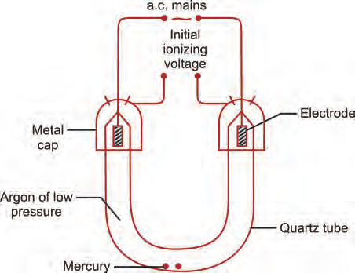
High Pressure Mercury Vapor Lamp
U-shaped glass tube, filled with argon gas at a low pressure.
Small amount of mercury is enclosed in the tube and the tube is sealed at both the ends.
U-shaped glass tube is used so as to act as a point source.
The burner is made up of quartz as this material allows the passage of ultraviolet rays and can withstand very high temperatures with low coefficient of expansion.
At the ends of the glass tube, electrodes are placed, enclosed in metal caps across which a high potential difference is applied.
Step-up transformer is used to apply high potential difference, i.e. 400 volts across the two metal caps surrounding ends of tube to ionize the argon gas.
Once the argon has been ionized, normal mains voltage between the electrodes causes the positive and negative particles to move through burner, constituting an electric current.
The electrons move toward the positive terminal and positive ions move toward the negative terminal, collision between moving ions and neutral argon atom causes further ionization and a glow of discharge is produced.
Also, sufficient heat is produced to vaporize the liquid mercury inside the tube and further ionization of mercury.

Slide 9
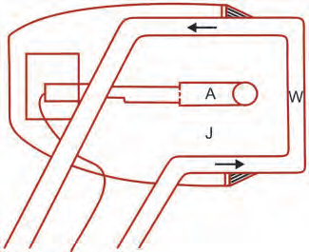
The Kromayer’s Lamp
The Kromayer’s lamp is a water-cooled mercury vapor lamp which eliminates the danger of burn and absorbs infrared rays.
The high pressure mercury vapor lamp is surrounded by circulating distilled water so as to absorb infrared rays.
Kromayer’s lamp can also be used to treat sinuses or deep body cavities.
Direct contact method can also be used as it minimizes the danger of burn.

Slide 10
Fluorescent Tubes
Mercury vapor lamp has disadvantage that it produces a certain proportion of short
ultraviolet rays.
Modern treatment methods often require the use of long waves ultraviolet rays only without having short waves.
In order to achieve this, fluorescent tubes are used.
Each tube is about 120 cm long and is made up of a glass which allows long ultraviolet
rays to pass.
The inside of tube is coated with special phosphor.
The spectrum of each tube depends upon the type of phosphor coating.
A low pressure arc is set up inside the tube by the process of ionization.
Phosphor is used to absorb short wave ultraviolet rays and these are reemitted at longer wavelengths.
Accurate control of emitted wavelength is possible depending upon the type of phosphor
used.

Slide 11
Theraktin Tunnel
The Theraktin tunnel is a semicylindricular framework in which four fluorescent tubes are mounted in its own reflector in such a way that an even irradiation of a patient is achieved.
Normally, fluorescent tubes with a spectrum of 280–400 nm are used.

Slide 12
PUVA Apparatus
Irradiation with UVA only, may be performed with special fluorescent tubes which may be mounted in a vertical battery on a wall or on four sides of a box totally surrounding the patient.
This form of ultraviolet rays are usually given for two hours after the patient has taken a photoactive drug such as Psoralen, hence the term PUVA (Psoralen-Ultraviolet-A) is used.

